Slide 1

Ethics, Bias, and Fairness Part II
Rayid Ghani and Kit Rodolfa

Slide 2
Reminders
This week:
No class / project check-ins on Wednesday/Thursday
Coming up next week:
Monday: update assignment – bias and fairness
Readings for Tuesday: causality and field validation
Project presentations on Wednesday

Slide 3
Monday Update
Google Slides Link

Slide 4
Project Presentations
https://canvas.cmu.edu/courses/25318/assignments/427022

Slide 5
Plan for the week
What you should be working on with your team this week (and next week)
Finalize model grid/runs
Review entire pipeline – sanity checks and completeness (cohort, labels, features, grid, etc.)
Model fairness metrics and evaluation
Review what’s needed for final presentation and report

Slide 6
Scope
Data
Exploration
Modeling
Get Data
Store Data
Link Data
Rows
Features
Labels
Model Selection
Train-Test Splits
Performance Metrics
Model Interpretation
Entities
temporal
Spatial
…
Models
Dealing with Bias and Fairness
Field Trial Design
Deployment
Monitoring
Goals, Actions, Data, Analysis, Ethics

Slide 7
Rawls’s Theory of Justice
Why did we ask you to read a moral philosophy text?
Moral philosophy is much more about frameworks to help approach tough problems and balance competing obligations than clear-cut answers
Rawls is far from the only voice here and many other perspectives are well worth exploring: utilitarianism (Singer), deontology (Kant), Scanlon, Sen, etc.

Slide 8
Rawls’s Theory of Justice
Make rules from the “original position” under a “veil of ignorance”
Rawls’s conclusions: equality in rights/duties & the difference principle
Maximize the position of the least-well-off in society (“maximin”)

Slide 9
Some questions we should be asking

Slide 10
Some questions we should be asking
Are you using data for purposes it’s intended for?
How are you protecting the data?
Do the people who “own” the data know you’re using it?
Do you have their permission? How was it obtained?
What actions are you taking on individuals based on this data?
Do the people you’re targeting know why and if they’re being targeted?
What recourse do they have?
Would it make the front page of NYT if they found out what you’re doing?

Slide 11
Data and AI Ethics Issues
Privacy
Data Ownership
Bias, Equity, & Fairness
Transparency
Trustworthiness and Accountability

Slide 12
Data and AI Ethics Issues
Privacy
Data Ownership
Bias, Equity, & Fairness
Transparency
Trustworthiness and Accountability

Slide 13
Common misconceptions in the real world
If I don’t use race in my analysis/models, then my analysis/models can’t be racist
If I use race in my models, then models are always racist
If my actions aren’t happening on individuals, then I don’t need to worry about bias

Slide 14
Fairness Research Agenda
Define (equity)
Understand
(root causes)
Improve (fairness)
Measure/ Detect (bias)
Mitigate
(the impact)
Monitor/
Evaluate
The focus is not on making the ML model fair but rather on making the overall system and outcomes fair

Slide 15
Where does Bias in ML/AI-based Systems come from?
The world
System Developers (Intentional bias)
Complexity of the System
Data
Sample Bias
Measurement Bias
Label Bias
Complexity or flaws in Methodology
Entire analysis/data pipeline
Action/Intervention Bias

Slide 16
What do we mean by “bias”? How can we measure it?

Slide 17
Many Bias Measures: How do we select what we care about?
Statistical/Demographic Parity
Impact Parity
False Discovery Rate Parity
False Omission Rate Parity
False Positive Rate Parity
False Negative Rate Parity
...

Slide 18
Many Bias Measures: How do we select what we care about?

Slide 19
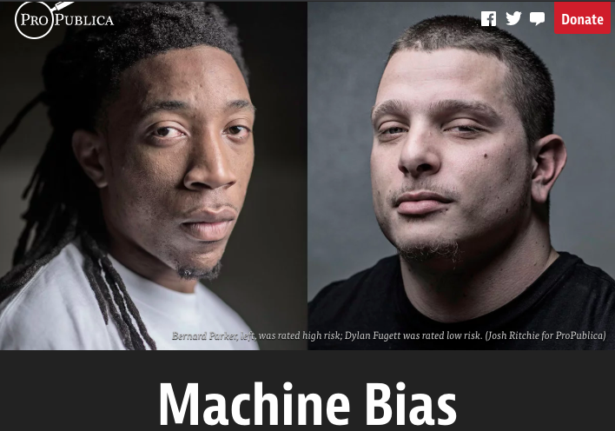
Incompatibility Between Fairness Metrics

Slide 20
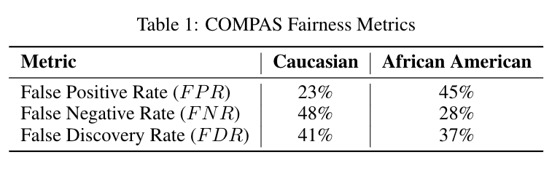
Incompatibility Between Fairness Metrics

Slide 21
Incompatibility Between Fairness Metrics
ProPublica identified considerable disparities:
The algorithm was twice as likely to incorrectly predict black individuals were at high risk of recidivating (FPR)
It was also nearly twice as likely to incorrectly predict white individuals were at low risk of recidivating (FNR)

Slide 22
Incompatibility Between Fairness Metrics
However, the creator of the algorithm pointed out that the algorithm is well-
balanced across races on precision (equivalently, FDR), claiming this is the
correct measure of fairness in this context.

Slide 23
Incompatibility Between Fairness Metrics
Who is right?
Is the COMPAS algorithm biased?
Can’t the algorithm achieve both measures of fairness at the same time?

Slide 24
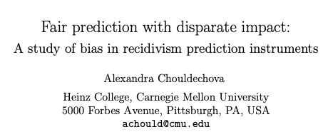
Incompatibility Between Fairness Metrics

Slide 25
Incompatibility Between Fairness Metrics

Slide 26
Incompatibility Between Fairness Metrics
False Positive Rate
Among all actual 0’s,
fraction predicted to be 1
False Negative Rate
Among all actual 1’s,
fraction predicted to be 0
Prevalence
Fraction of
actual 1’s in
population
False Discovery Rate
Among all predicted 1’s,
fraction that are actual 0’s
=(1 – precision)

Slide 27
Incompatibility Between Fairness Metrics
If prevalence is
unequal across
groups...

Slide 28
Incompatibility Between Fairness Metrics
If prevalence is
unequal across
groups...
…and FDR (or precision)
is equal across groups...

Slide 29
Incompatibility Between Fairness Metrics
If prevalence is
unequal across
groups...
…and FDR (or precision)
is equal across groups...
…then either FPR or FNR can be equal across groups, but not both

Slide 30
So… what does this mean?
Unfortunately, we can’t ensure parity across all metrics at the same time…
But this also doesn’t mean fairness is unachievable or we shouldn’t bother.
Instead, it means we have to carefully consider and choose the appropriate fairness metrics for our context

Slide 31
Some Motivating Case Studies
Lead Poisoning
Blight Violations
Student Tutoring

Slide 32
Some Motivating Case Studies
Assessing damage from natural disasters via social media
Bank loan denial decisions based on default risk
Prioritizing housing inspections based on risk of lead poisoning

Slide 33
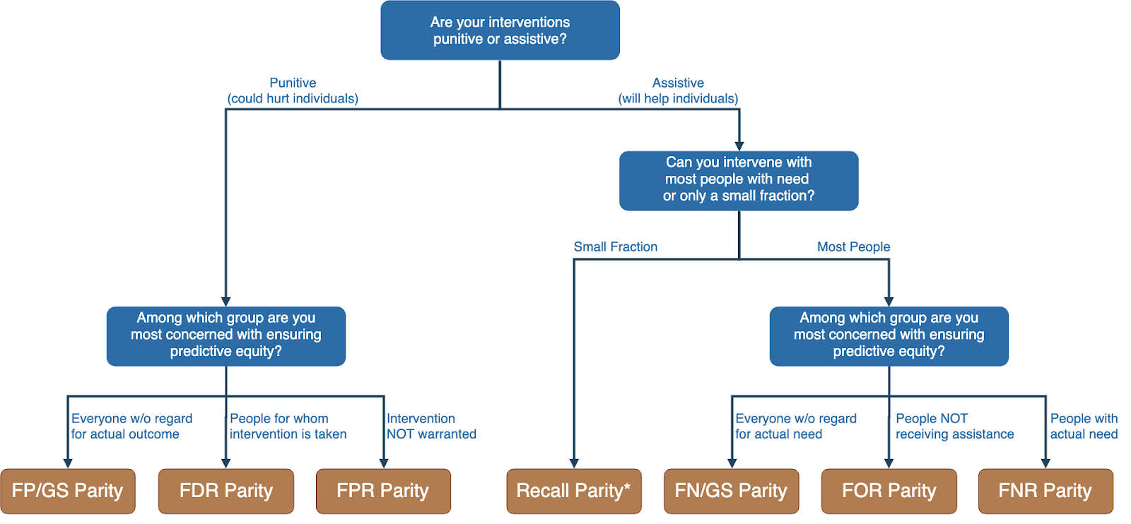
Translating policy goals to fairness metrics

Slide 34
Is the fairness tree “the answer”?

Slide 35
Is the fairness tree “the answer”?
No… but it’s intended as a starting point to help guide a conversation between ML experts, policy makers, and those affected by the decisions.
Ultimately, the choice of fairness metric(s) is highly dependent on context and stakeholder values.

Slide 36
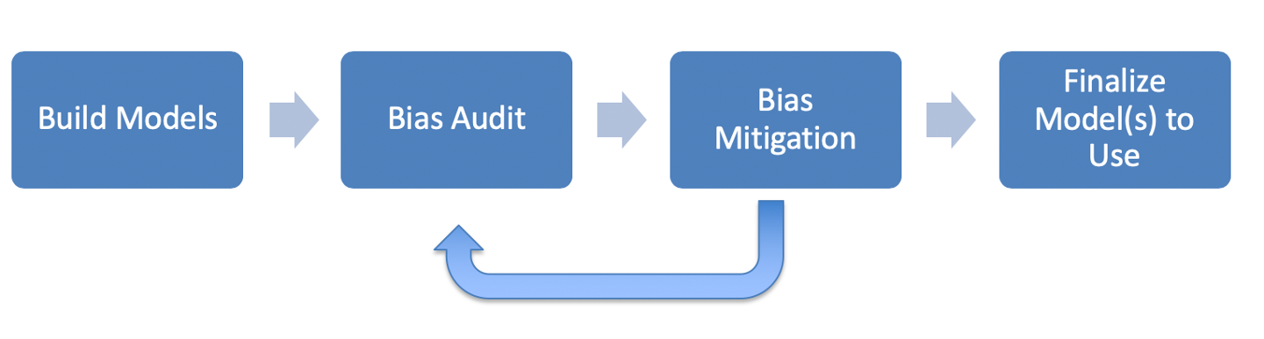
ML Fairness Workflow

Slide 37
How can we reduce bias in ML models?
Fix the world
Pre-Processing: Fix the input data
Remove sensitive attributes (and correlated ones)
Resample and/or reweight protected groups
In-Processing: Optimize for fairness in model training
Post-Processing
Choose fair models during model selection
Post-hoc adjustments to ‘de-bias’ model scores

Slide 38
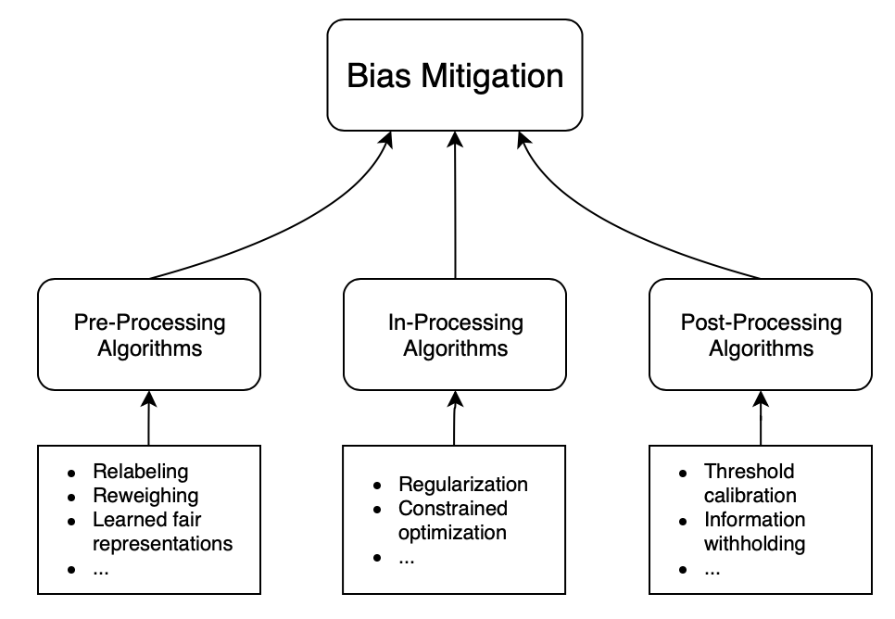
How can we reduce bias in ML models?

Slide 39
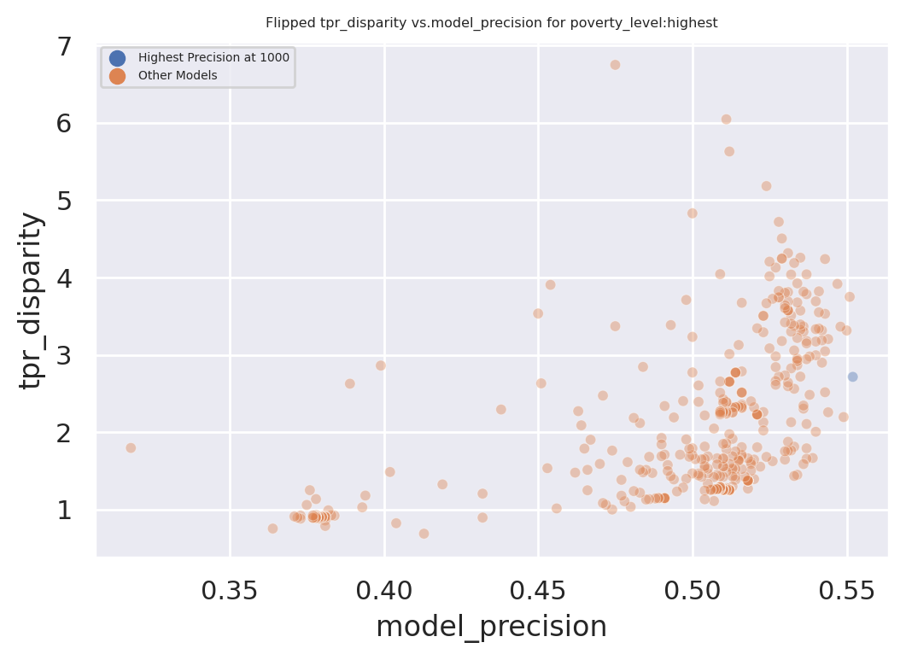
Exploring Trade-Offs
Each point is a different
model specification
Disparity
Precision@k

Slide 40
Exploring Trade-Offs
Each point is a different
model specification
Points further to the right
are more accurate
Disparity
Precision@k

Slide 41
Exploring Trade-Offs
Each point is a different
model specification
Points further to the right
are more accurate
Points closer to 1 on the
y-axis are more fair
Disparity
Precision@k

Slide 42
Exploring Trade-Offs
Disparity
“Best” model just based
on top k precision
Precision@k

Slide 43
Exploring Trade-Offs
Disparity
Pareto Frontier
Precision@k

Slide 44
Exploring Trade-Offs
Disparity
Our hope:
Fairness-improving
methods can expand this
frontier by adding new
points
Precision@k

Slide 45
Calculating Fairness Metrics for Your Models: aequitas
Triage can calculate various fairness metrics and disparities automatically for you using the aequitas bias audit tool
Specify a bias_audit_config in your triage config
Re-run your models using replace=False
Results can be found in test_results.aequitas

Slide 46
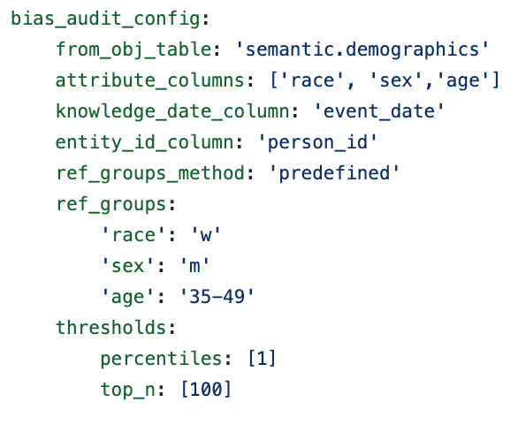
Calculating Fairness Metrics for Your Models: aequitas

Slide 47
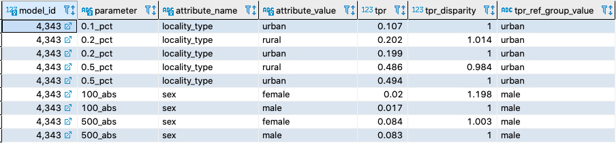
Calculating Fairness Metrics for Your Models: aequitas

Slide 48
Reminders
This week:
No class / project check-ins on Wednesday/Thursday
Coming up next week:
Monday: update assignment – bias and fairness
Readings for Tuesday: causality and field validation
Project presentations on Wednesday

Slide 49
Appendix

Slide 50
Legal and Social Principles
Choices about fairness and equity are implicit in any decision process but being made explicit by the growing use of algorithmic decision support.

Slide 51
Legal and Social Principles
Choices about fairness and equity are implicit in any decision process but being made explicit by the growing use of algorithmic decision support. What implicit choices about fairness are encoded when we say…
Beyond a reasonable doubt? (e.g., criminal court)
The preponderance of evidence? (e.g., civil court)
Probable cause? (e.g., indictment by grand jury)
Innocent until proven guilty?

Slide 52
Legal Perspectives and Challenges
Title VII of US Civil Rights Act – Job Discrimination
Disparate Treatment (intentional discrimination)
Disparate Impact (regardless of intention)
14th Amendment
Equal Protection (under laws and government actions)
“Strict Scrutiny” Standard: compelling state interest, narrowly tailored, and least restrictive means
Notes:
14th Amendment often interpreted to prohibit racial classification in most cases (that is, taking race into account in state decision-making) as well as racial intentions/discriminatory purpose

Slide 53
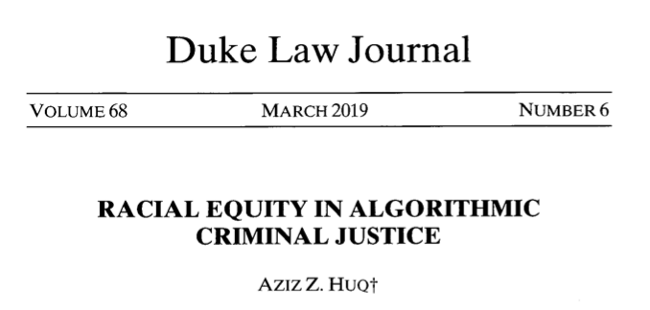
Legal Perspectives and Challenges

Slide 54
Legal Perspectives and Challenges
What Challenges Does Huq Identify Applying Current Legal Standards to Algorithmic Decision Making?

Slide 55
Legal Perspectives and Challenges
What Challenges Does Huq Identify Applying Current Legal Standards to Algorithmic Decision Making?
Expanded scale and reach of state power
Durability of errors – need for special skills to update/fix problems
What does “discriminatory intent” mean in this context?
Unclear how to apply “anticlassification” standard of equal protection

Slide 56
Legal Perspectives and Challenges
Difficulties with Equal Protection’s “Anticlassification” Standard:
Simply omitting race as a feature doesn’t ensure an algorithm is “colorblind” – too much correlated information in other features
Accounting for race may in fact be needed to decrease disparities

Slide 57
Legal Perspectives and Challenges
Drug Possession Rates
 | Black | White
Baseball Cap | 0% | 100%
No Cap | 2% | 2%

Slide 58
Legal Perspectives and Challenges
Drug Possession Rates
 | Black (25% of Pop.) | White (75% of Pop.)
Baseball Cap | 0% | 100%
No Cap | 2% | 2%
Race-Blind Policy:
75% Precision
Many Needless Searches of Minorities

Slide 59
Legal Perspectives and Challenges
Drug Possession Rates
 | Black (25% of Pop.) | White (75% of Pop.)
Baseball Cap | 0% | 100%
No Cap | 2% | 2%
Race-Aware Policy:
100% Precision
No Needless Searches of Minorities

Slide 60
Legal Perspectives and Challenges
How does Huq suggest modifying our criteria for assessing discrimination in this new context?

Slide 61
Legal Perspectives and Challenges
“Rather than asking about abstract definitions of fairness, a criminal justice algorithm should be evaluated in terms of its long-term, dynamic effects on racial stratification… [and] focus on the net burden thereby placed on the racial minority.”

Slide 62
Three Concepts of Fairness in ML
We’ve focused here on the concept of group fairness – balancing aggregate metrics across groups
Some also study the concept of individual fairness – that similar individuals should be treated similarly
An important related line of work concerns counterfactual fairness – how would your prediction if you were a member of a different group?

Slide 63
Practical Challenges with Individual Fairness
How do you measure “similarity”? Over what distance metric and what features?
Individual fairness doesn’t guarantee group fairness (but also vice-versa)
In the light of existing or historical discrimination, the protected attribute / group membership might be an important measure of dissimilarity in itself

Slide 64
Where does this leave us?
What can we do to understand bias and improve fairness of our systems?
Bias and equity audits
Try to fix the input data
Optimize for fairness in model training
Choose fair models during model selection
Post-hoc adjustments to de-bias model scores
Measure relative effectiveness of interventions across groups and develop better-tailored interventions

Slide 65
Bias and Fairness Workflow
Define
Understand (root causes)
Improve (fairness)
Measure/ Detect (bias)
Mitigate (the impact)
Monitor &
Evaluate
- Metrics(s)
- Groups
- Audit model(s) for bias across metric(s) and groups
Data
ML pipeline components
Actions
Pre-Processing
Modeling (e.g. regularization)
Post-processing
Design appropriate actions

Slide 66
Bias and Fairness Workflow
Define
Understand (root causes)
Improve (fairness)
Measure/ Detect (bias)
Mitigate (the impact)
Monitor &
Evaluate
- Metrics(s)
- Groups
- Audit model(s) for bias across metric(s) and groups
Data
ML pipeline components
Actions
Pre-Processing
Modeling (e.g. regularization)
Post-processing
Design appropriate actions

Slide 67
Many Bias Measures: How do we select what we care about?

Slide 68
Translating policy goals to fairness metrics

Slide 69
Bias and Fairness Workflow
Define
Understand (root causes)
Improve (fairness)
Measure/ Detect (bias)
Mitigate (the impact)
Monitor &
Evaluate
- Metrics(s)
- Groups
- Audit model(s) for bias across metric(s) and groups
Data
ML pipeline components
Actions
Pre-Processing
Modeling (e.g. regularization)
Post-processing
Design appropriate actions

Slide 70

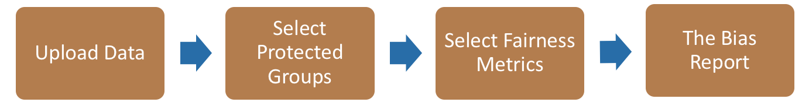
Bias Audit Flow
Race
Sex
Age
Equal False
Omission Rate
Risk Score and Outcomes

Slide 71
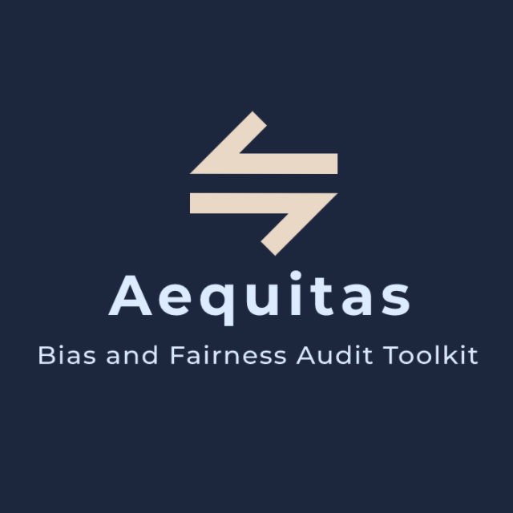
Bias Audit
http://www.datasciencepublicpolicy.org/aequitas/

Slide 72
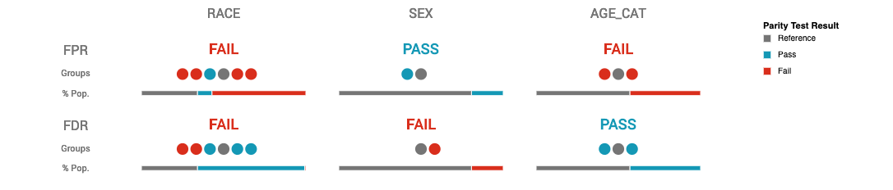
Auditing COMPAS Disparities

Slide 73
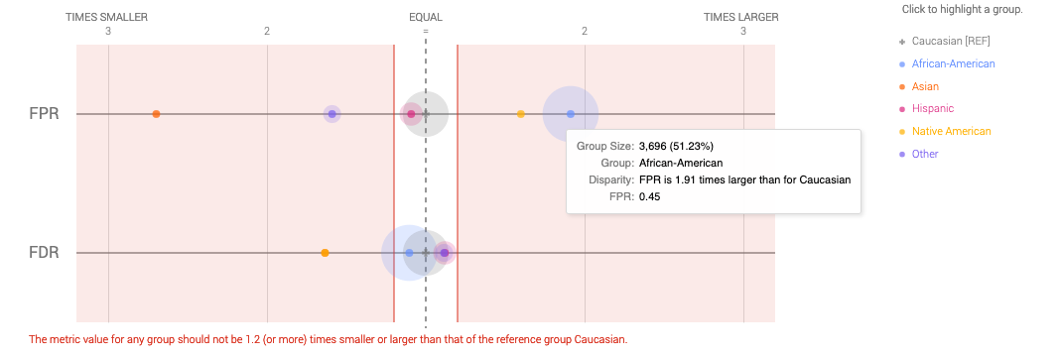
Auditing COMPAS Disparities

Slide 74
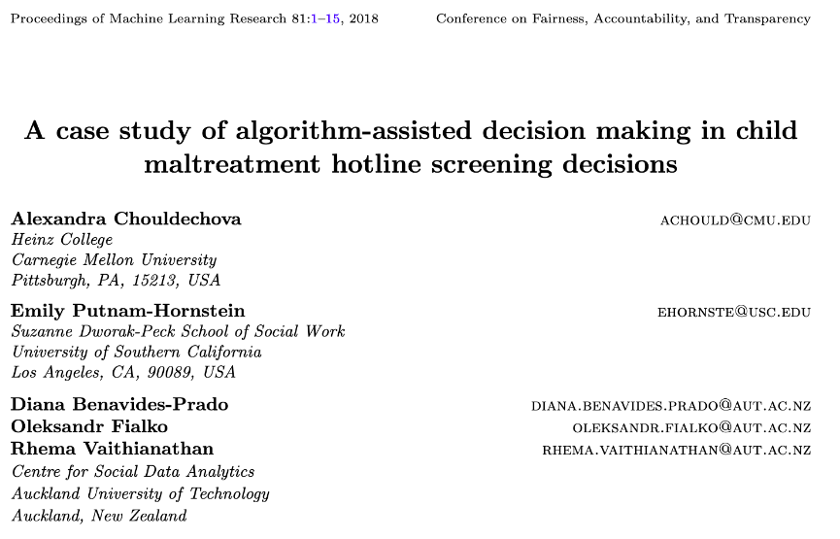
Child Welfare Case Study

Slide 75
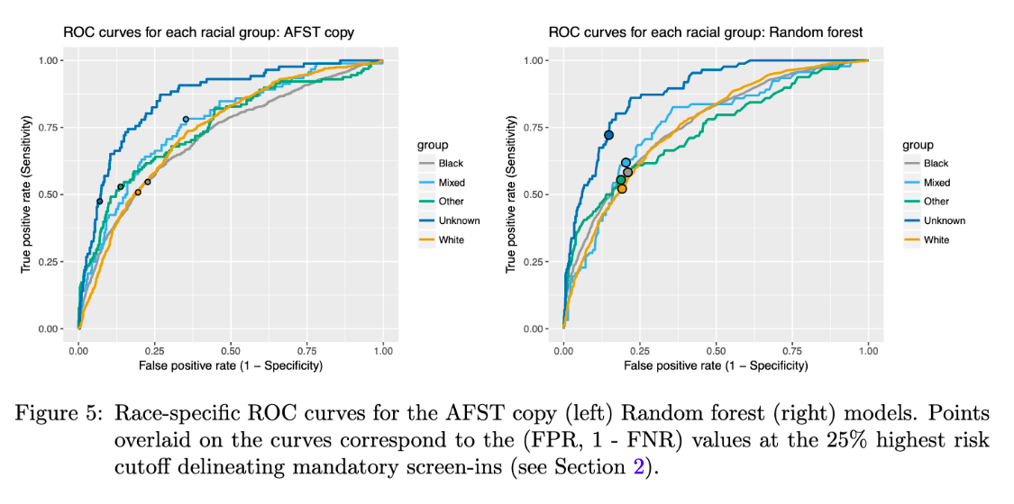
Child Welfare Case Study

Slide 76
Child Welfare Case Study
“We see that even though the ROC curves lie quite close to one another for most groups, the chosen threshold corresponds to different points on the ROC curves for different groups…. This FPR imbalance could lead to a perception that Mixed-race families are over- investigated relative to White families.
”

Slide 77
Bias and Fairness Workflow
Define
Understand (root causes)
Improve (fairness)
Measure/ Detect (bias)
Mitigate (the impact)
Monitor &
Evaluate
- Metrics(s)
- Groups
- Audit model(s) for bias across metric(s) and groups
Data
ML pipeline components
Actions
Pre-Processing
Modeling (e.g. regularization)
Post-processing
Design appropriate actions

Slide 78
Bias (in outcomes) can come from any of these four components
World
ML Pipeline
Actions
Data
Sample Bias
Measurement Bias
Label Bias
System Developers
Complexity or flaws
Design Choices

Slide 79
Bias and Fairness Workflow
Define
Understand (root causes)
Improve (fairness)
Measure/ Detect (bias)
Mitigate (the impact)
Monitor &
Evaluate
- Metrics(s)
- Groups
- Audit model(s) for bias across metric(s) and groups
Data
ML pipeline components
Actions
Pre-Processing
Modeling (e.g. regularization)
Post-processing
Design appropriate actions

Slide 80
Improving Fairness of Models
Pre-Processing: Try to fix the input data
In-Processing: Optimize for fairness in model training
Model Selection: Choose fair models during model selection
Post-Processing: Post-hoc adjustments to de-bias model scores

Slide 81
Fairness-aware Model Selection
0%
Performance Metric
100%

Slide 82
Fairness-aware Model Selection
100%
Bias
0%
Performance Metric
100%

Slide 83
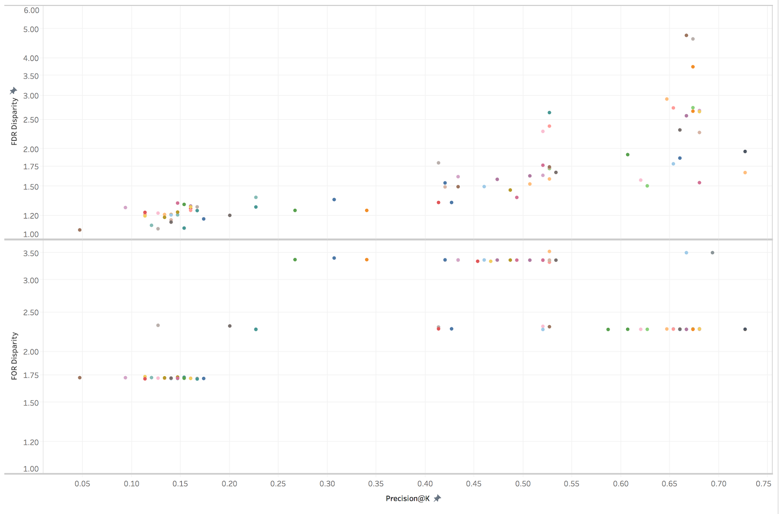
Fairness-aware Model Selection
Bias vs P@1% on Gender
False Discovery Rate Disparity
False Omission Rate Disparity
Precision at the top 1%

Slide 84
Improving Fairness of Models
Pre-Processing: Try to fix the input data
In-Processing: Optimize for fairness in model training
Model Selection: Choose fair models during model selection
Post-Processing: Post-hoc adjustments to de-bias model scores

Slide 85
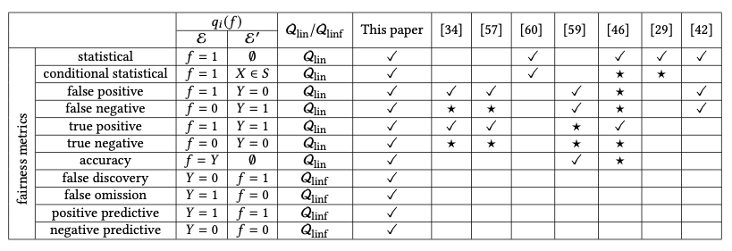
Optimize for Fairness in Model Training
General idea: modify optimization problem (for instance, by adding regularization terms to loss function) that account for fairness. Many implementations of different methods for various fairness metrics.

Slide 86
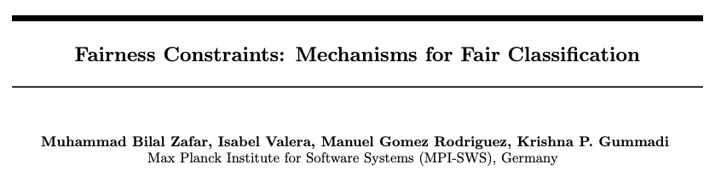
Optimize for Fairness in Model Training

Slide 87
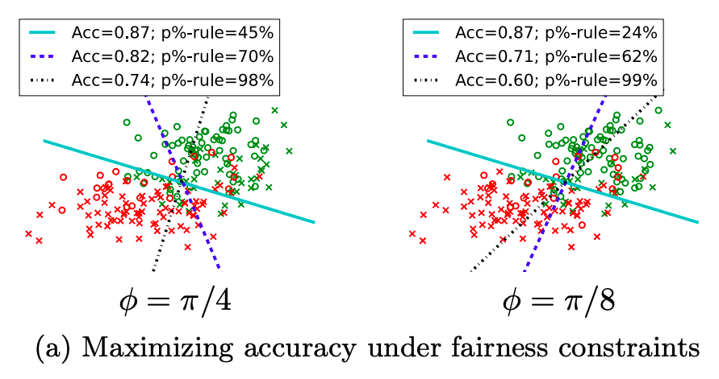
Optimize for Fairness in Model Training

Slide 88
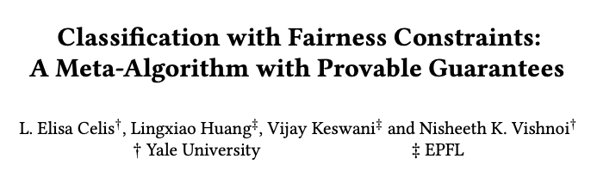
Optimize for Fairness in Model Training

Slide 89
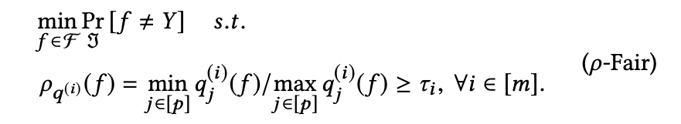
Optimize for Fairness in Model Training

Slide 90
Optimize for Fairness in Model Training
“group performance function”
capturing the equity metric
of interest

Slide 91
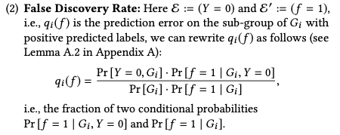
Optimize for Fairness in Model Training
for example:

Slide 92
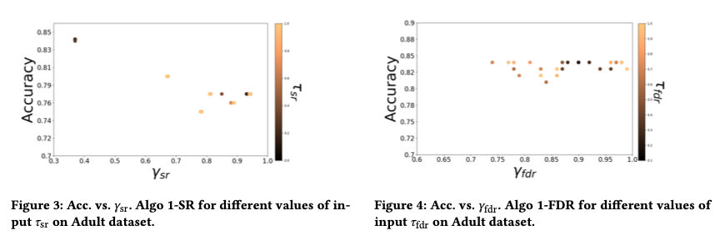
Optimize for Fairness in Model Training

Slide 93
Optimize for Fairness in Model Training: Advantages
Idea of an “all-in-one” solution is appealing
Provides some flexibility, especially when group membership not known exactly (e.g., gender estimated from name or race from census data)

Slide 94
Optimize for Fairness in Model Training: Limitations
Limited set of algorithms to do this directly, though also black-box options (often end up doing the same thing as post-hoc score adjustments)
Doesn’t preclude the need to auditing, assessment, and model selection – need to confirm the effectiveness of the constraint!
Generally don’t work well for “top k” problems off the shelf

Slide 95
Improving Fairness of Models
Pre-Processing: Try to fix the input data
In-Processing: Optimize for fairness in model training
Model Selection: Choose fair models during model selection
Post-Processing: Post-hoc adjustments to de-bias model scores

Slide 96
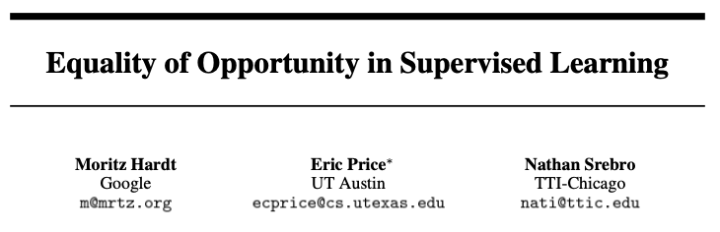
Post-hoc Adjustments

Slide 97
Post-hoc Adjustments
aka recall or TPR

Slide 98
Post-hoc Adjustments
“That is, to require that people who pay back their loan have an equal opportunity of getting a loan in the first place.
”

Slide 99
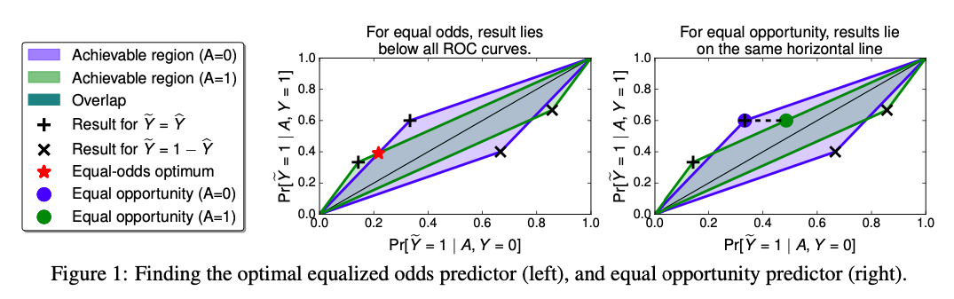
Post-hoc Adjustments

Slide 100
Case Study: Post-hoc Adjustments and Policy Goals
Cycle of Incarceration
UNMET
NEEDS
MISDEMEANOR
ARREST
JAIL
worsening or failing to improve

Slide 101
Case Study: Post-hoc Adjustments and Policy Goals
Breaking the Cycle
UNMET
NEEDS
X
MISDEMEANOR
ARREST
JAIL
TAILORED
INTERVENTION

Slide 102
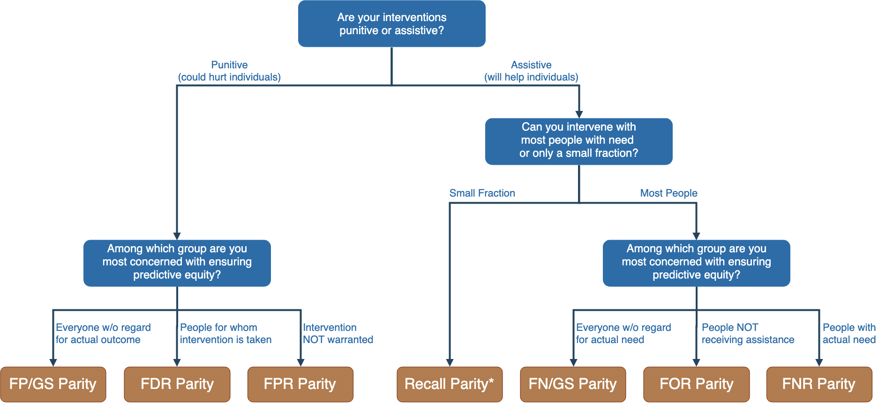
Notes:
Context-dependence of fairness definition
Idea of fairness tree is starting point for conversations with stakeholders, help guide discussion
In assistive program with resource constraints, focus on recall parity (equivalent to equality of opportunity discussed by Hardt and others --- also “sensitivity” and TPR and 1-FNR)

Slide 103
Notes:
Context-dependence of fairness definition
Idea of fairness tree is starting point for conversations with stakeholders, help guide discussion
In assistive program with resource constraints, focus on recall parity (equivalent to equality of opportunity discussed by Hardt and others --- also “sensitivity” and TPR and 1-FNR)

Slide 104
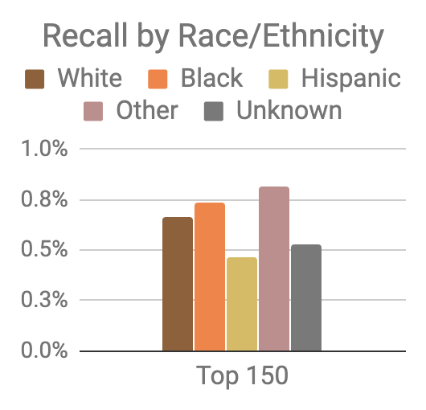
Model was optimized for efficiency, not equity
Top 150 highest risk reasonably balanced between black and white individuals
However, hispanic and unknown race/ethnicity groups very underrepresented

Slide 105
Mitigating Disparities
Single Threshold
White
Black
Hispanic
Recall
Lower Scores / Higher Recall
Group Thresholds
Recall

Slide 106
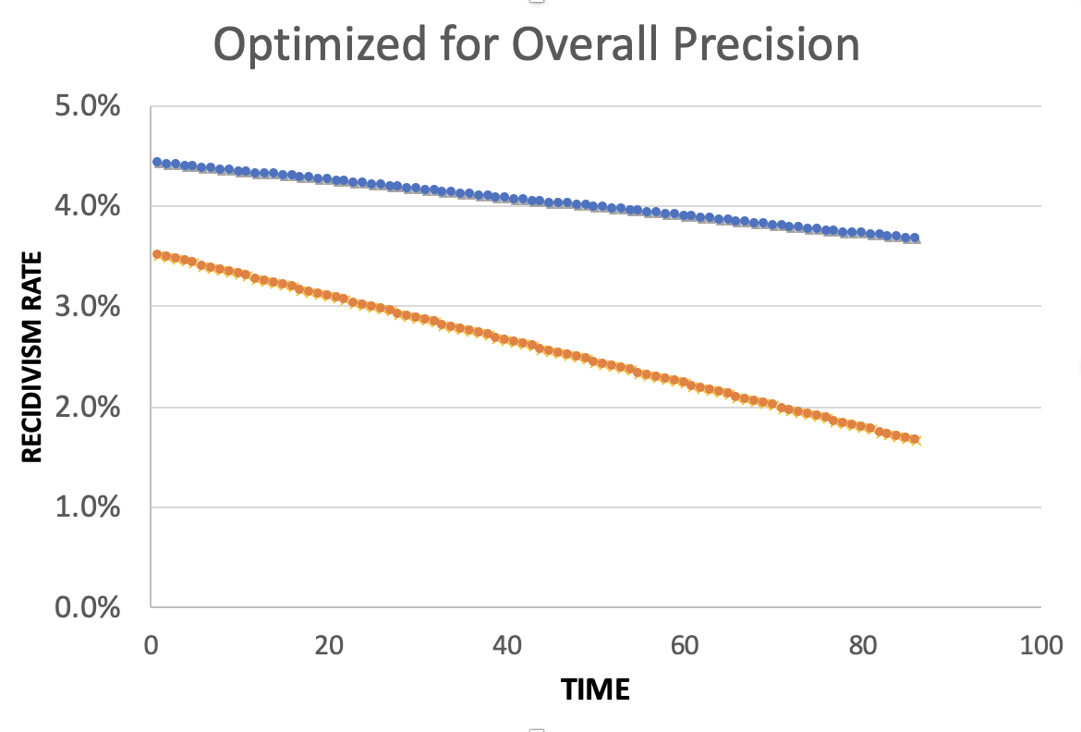
Equality of Predictions vs Underlying Disparities
Widening Gap:
Disparities Getting
Larger Over Time

Slide 107
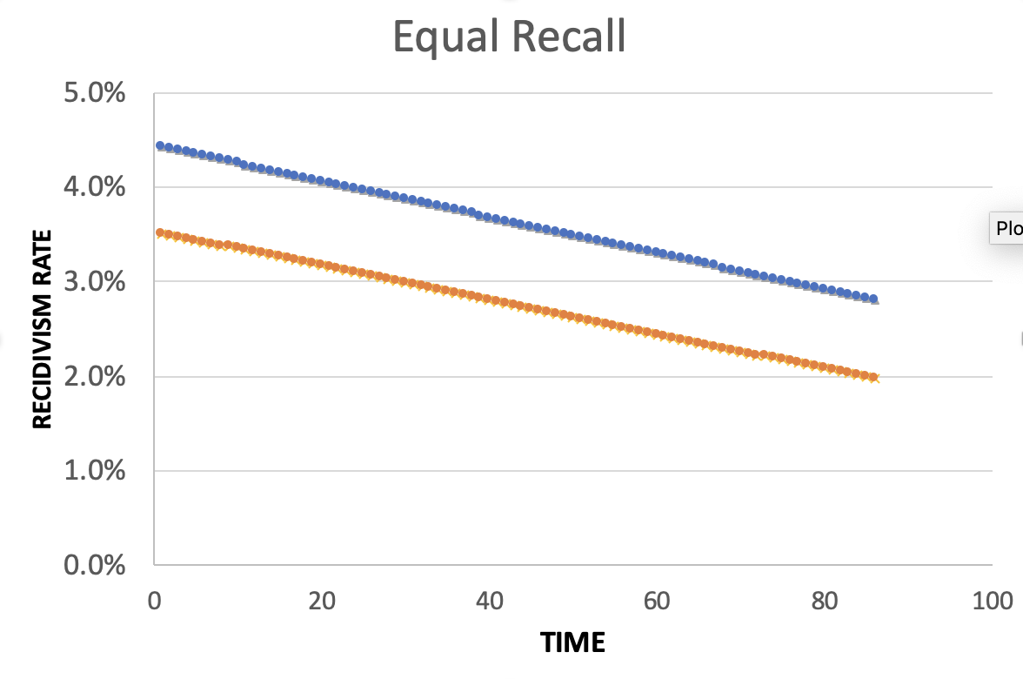
Equality of Predictions vs Underlying Disparities
Parallel Lines:
Disparities Remain
Constant Over Time

Slide 108
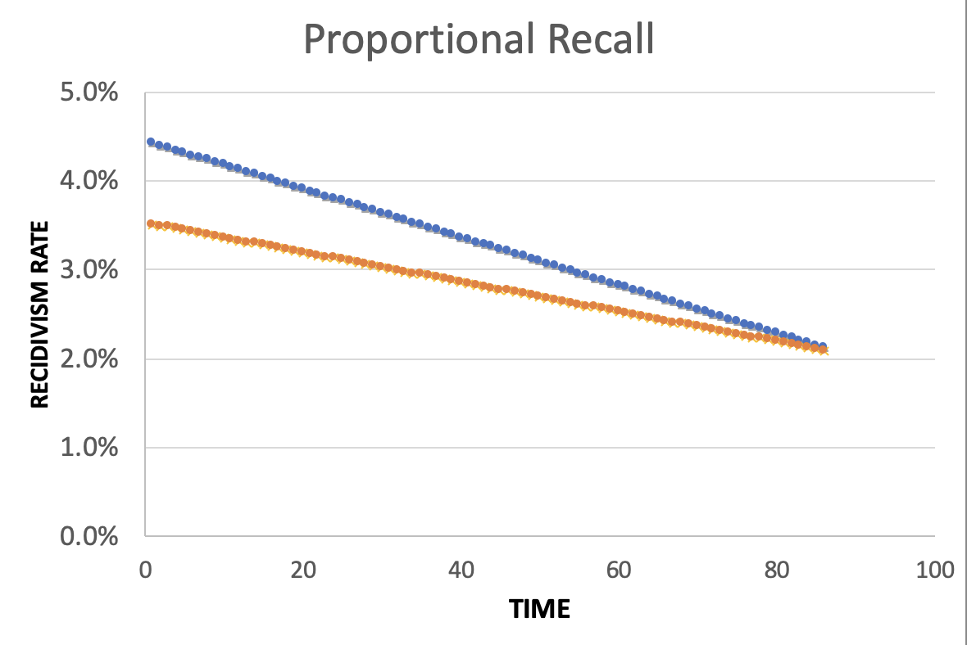
Equality of Predictions vs Underlying Disparities
Converging Lines:
Disparities Decrease
Over Time

Slide 110
Menu of Options
Current Scale
Expanded Scale
No
Constraint
Equalize
Recall
Reduce
Disparities

Slide 111
Menu of Options
Current Scale
Expanded Scale
No
Constraint
INITIAL
MODEL
Equalize
Recall
Reduce
Disparities

Slide 112
Menu of Options
Current Scale
Expanded Scale
No
Constraint
Equalize
Recall
EXPLICIT
EQUITY / EFFICIENCY
TRADE-OFF
“COST OF
EQUITY”
Reduce
Disparities

Slide 113
Menu of Options
Current Scale
Expanded Scale
No
Constraint
Equalize
Recall
IMPROVE OUTCOMES AT SAME
RATE ACROSS GROUPS
Reduce
Disparities
IMPROVE OUTCOMES FASTER FOR GROUPS
WITH HIGHER INCARCERATION RATES
Notes:
For the “Reduce Disparities” options, we targeted recall levels in proportion to underlying prevalence in the population. Could make other choices, but this has the nice property of readjusting as these prevalences change while also still distributing resources across all groups, but one could reasonably take many possible approaches.

Slide 114
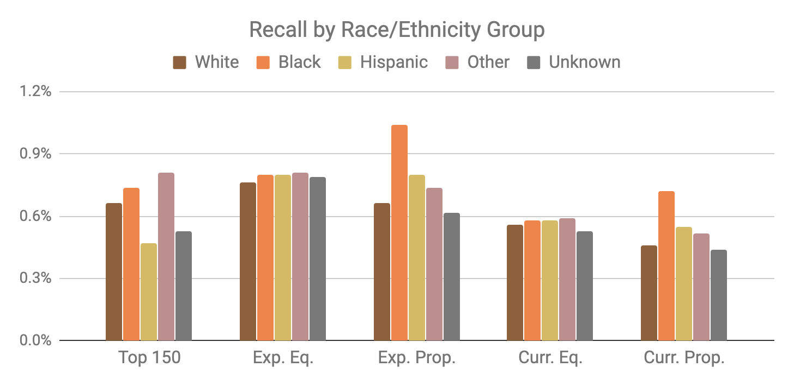
Base Model
Expanded Scale
Current Scale

Slide 115
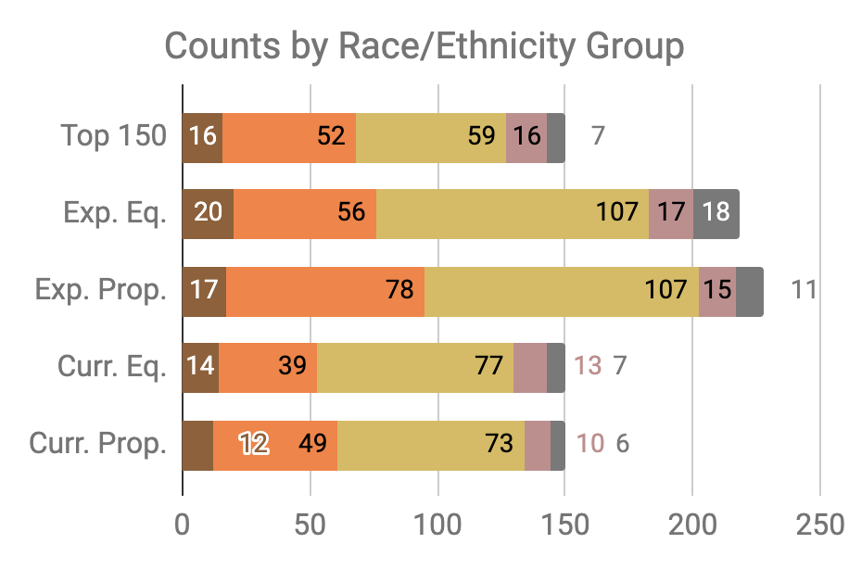

Slide 116
Little Equity/Efficiency Trade-Off at Current Scale
Top 150
72.7%
Precision
150
Total Count
Equal
Recall
70.7%
Precision
150
Total Count
Proportional
Recall
70.7%
Precision
150
Total Count

Slide 117
Improving Fairness of Models
Pre-Processing: Try to fix the input data
In-Processing: Optimize for fairness in model training
Model Selection: Choose fair models during model selection
Post-Processing: Post-hoc adjustments to de-bias model scores

Slide 118
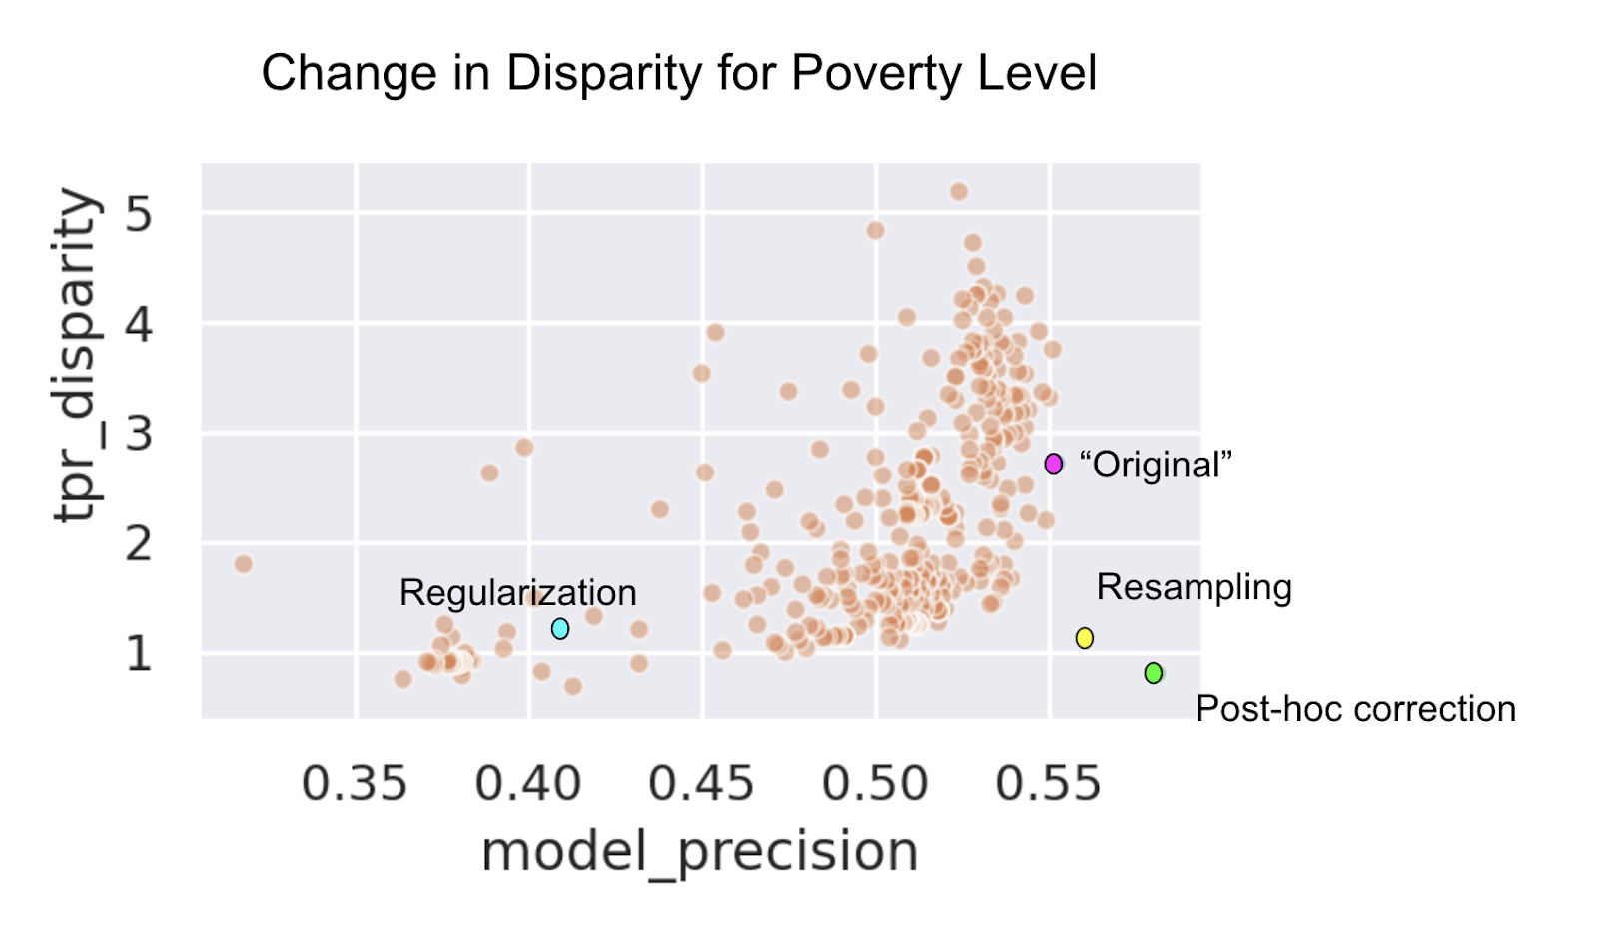

Slide 119
Data and AI Ethics Issues
Privacy
Data Ownership
Bias, Equity, & Fairness
Transparency
Trustworthiness and Accountability

Slide 120
Summary
Create an environment where informed ethical discussions can take place
Talk through ethical issues at each stage of the project (instead of waiting till the end of stopping after the initial setup)
Consider the entire chain of data - collection to analysis to action
Consider how it affects people throughout the chain – especially the people being affected (and include them in these discussions)
Embed ethics into both technical processes as well as people processes

Slide 121
Readings
Policy Paradox
Ethics and Data Science
Ethics and Policy in Data Science (Class at Cornell)
First, Do No Harm
FATML (workshops that have been happening for the past 4 years)

Slide 122
Useful resources we’ve created
Bias and Fairness in ML tutorial
Fairness Tree
Aequitas: Bias Audit Tool [description] [code]
Bias in ML Book Chapter

